Slide 1
Group 1: TAP Mobile
DCR ARB: November 19th, 2013
Andrew Borba, Elisabeth Brooks, Jorge Go, Katherine Hu, Nakul Joshi, Ian Malave, Rishi Mukhopadhyay

Slide 2
Overview
Partnering with TAP to create an application to be used as an alternative to the existing TAP cards
Using LA Metro as proof of concept for the application
Creating an app that can later be expanded and applied to any transportation lines that use TAP cards

Slide 3
System Overview and Purpose
System Purpose
System Overview
Changes in Current System and Deficiencies
Proposed New System
System Boundary & Environment
Element Relationship Diagram
Desired Capabilities and Goals
Top Level Scenario

Slide 4
System Purpose
Convenience to metro riders and TAP Card users
Eliminates the need to keep track of physical TAP cards
Decreases cost for the LA Metro and ticket buyers by eliminating physical footprint
Increase efficiency of the public transportation system through advancing technologically
Acts as a proof of concept that can be implemented for other TAP using transportation systems
Ability to add funds to account from their mobile device- don’t need to go to a physical location to purchase card

Slide 5
System Overview
Key Partners
TAP
LA Metro
Key Activities
Software Design and Development
Integration with Metro Infrastructure
Application Testing & Feedback
Application Awareness & Marketing
Key Resources
Development Team
PhoneGap API
NFC & QR Technology
Oracle Database
Siebel Web Interface
Metro Schedule and News API
Devices for testing

Slide 6
System Overview (continued)
Value Proposition
Convenience for customers to purchase and use metro tickets
Elimination of physical tickets
Technological advancement of transportation system
Customer Relation
TAP
Apple App Store
Android Store
Windows Phone Marketplace
Channels
Application Stores (on mobile devices)
LA Metro Website
TAP Website
Posters and Billboards at Stations

Slide 7
System Overview (continued)
Customer Segments
Transportation Companies
Cost Structure
Development Team
Back End System Administration
Revenue Streams
Flat fee for project implementation
Recurring fee per ticket sale through application

Slide 8
Changes in Current System & Deficiencies
Revaluated the scope
Looked at existing metro app and capabilities, and redefined necessary features
Focusing on features and capabilities that don’t currently exist in metro app
Basic needs:
Account creation
Loading money
Using app
Since this system needs to support such a large number of users, these features needs to be perfected and scalable.

Slide 9
Proposed New System
A smartphone application to replace TAP cards
Used to purchase tickets and board trains/busses
Full backwards compatibility with existing TAP/Metro infrastructure
Display passes as QR codes
Passes validated by cameras on turnstiles
A supplementary app for use by Metro agents to validate passes

Slide 10
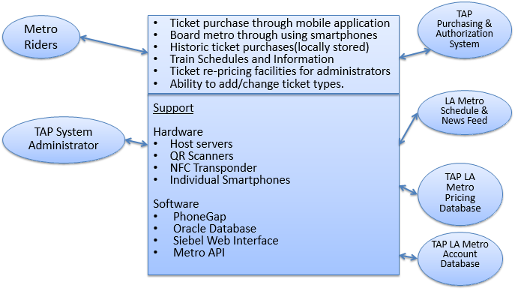
System Boundary and Environment

Slide 11
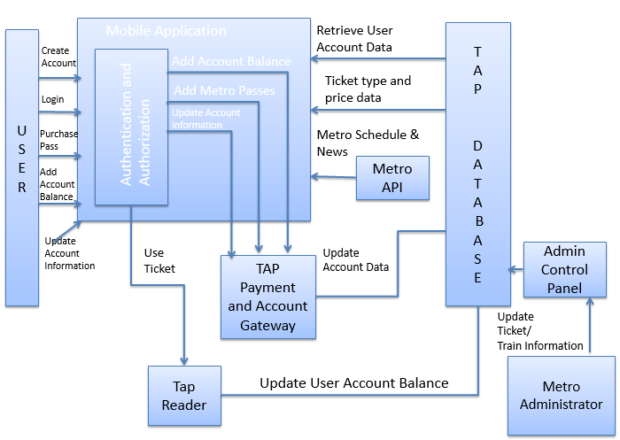
Element Relationship Diagram

Slide 12
Desired Capabilities and Goals
Desired Capabilities Overview:
A fully functioning app that can serve as an alternative or compliment to the current TAP cards. Allows users to create accounts, load money, and use the Application to board the Metro.
Goals:
Cross-platform compatibility
Ease of use
Security of User Information
Inner-Operability with current metro infrastructure
Maintainability

Slide 13
Top Level Scenarios
Overview of User Scenarios and Features:
Account creation, modification and deletion
Payment processing
Metro schedule and destination viewing
Ticket purchasing
Communication with Gate/Turnstile
Connectivity to TAP/LA Metro Databases
Ticket Verification

Slide 14
Prototype
Prototype Survey
Survey Results
Updates in Prototype
Changes in Significant Capabilities
Prototype Demo

Slide 15
Prototype Survey
Sent out a survey to over to get feedback on previous prototype
Survey participants included a diverse group of over 40 people
Colorblind testers
Frequent and non-frequent Metro riders
Males and females of different ages

Slide 16
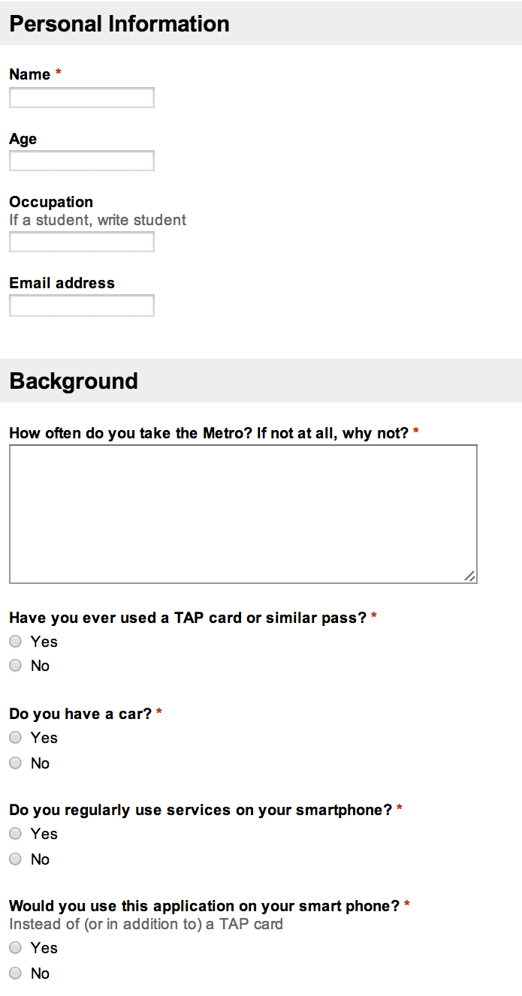
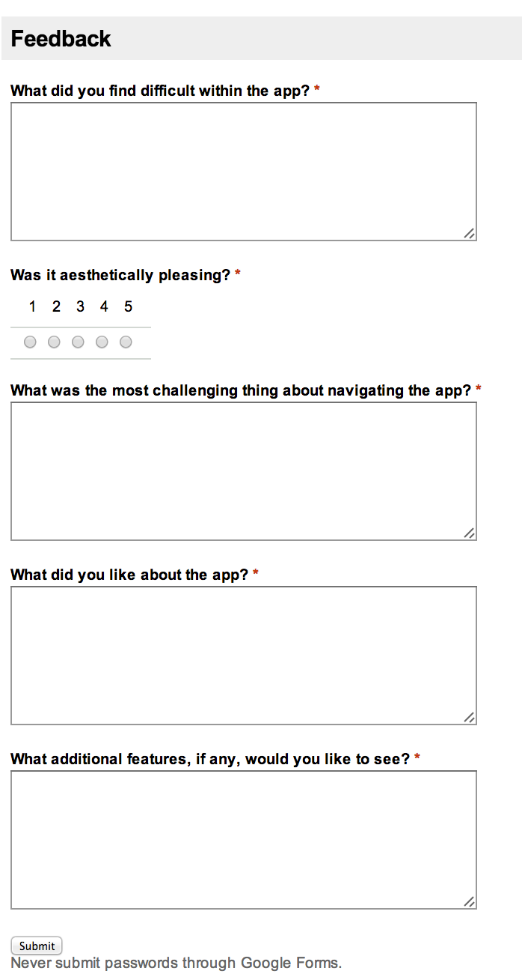
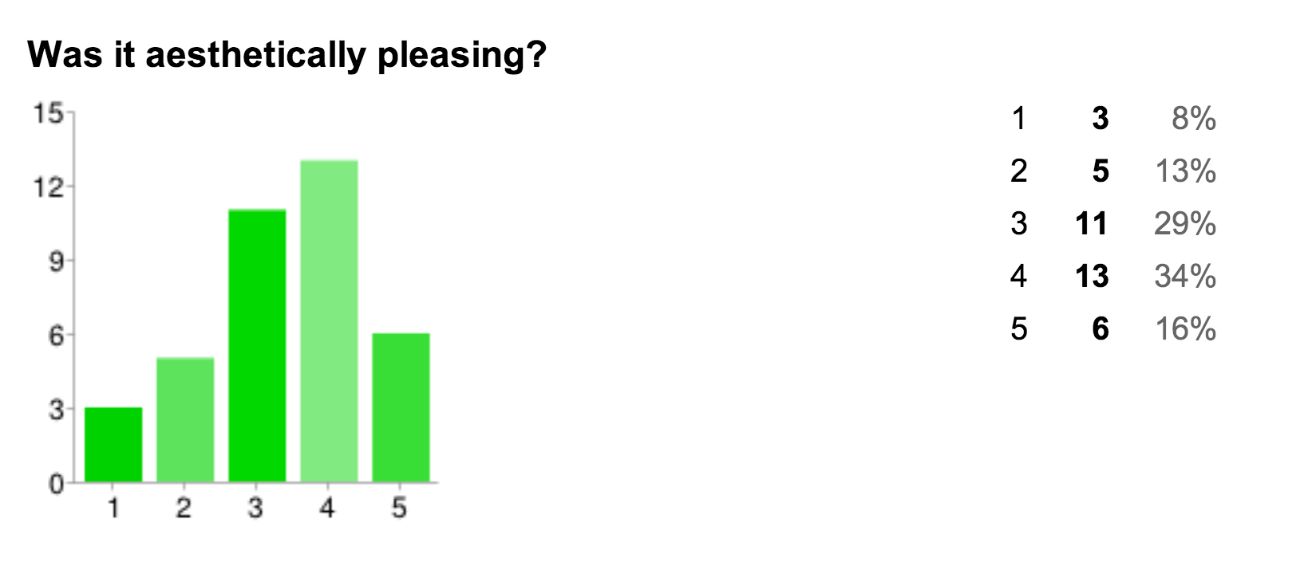
Survey Results
Feedback survey (n=38) key results:
Location setting is confusing
Ticket is hard to purchase and then find
Times for nearby transportation are important
Color scheme is attractive

Slide 17
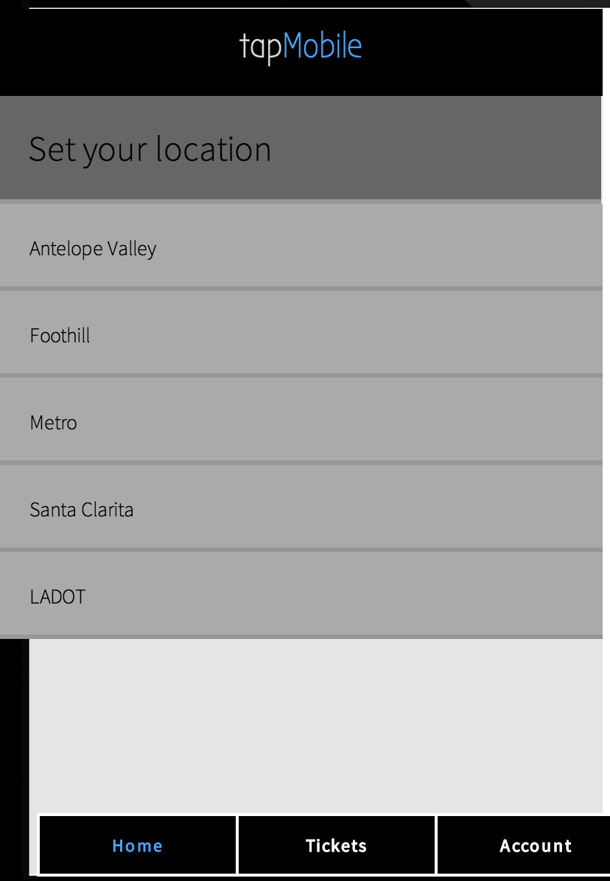
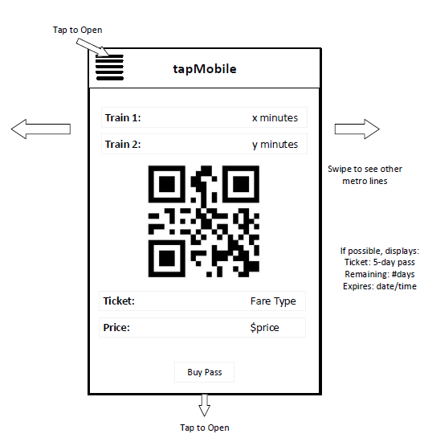
Updates in Prototype
Completely redesigned interface based on survey results and feedback:
Version 1
Version 2

Slide 18
Changes in Significant Capabilities
Support for linking additional tap accounts for the purpose of allowing dependents to be charged with one QR scan
Ex: a mom would create tap accounts for her kids, links those accounts to her account through the app and then can use her phone to scan the kids in
App will use your location (updated ~every 2 minutes) to find the nearest metro line to location and will automatically display your ticket on the home screen
If GPS is off or you're using the bus, ability to manually choose a ticket from list as well
The home screen will display arrival times of the nearest train line to currently location along with destination of train
Visually display any special statuses such as senior citizen, child or any discount passes

Slide 19
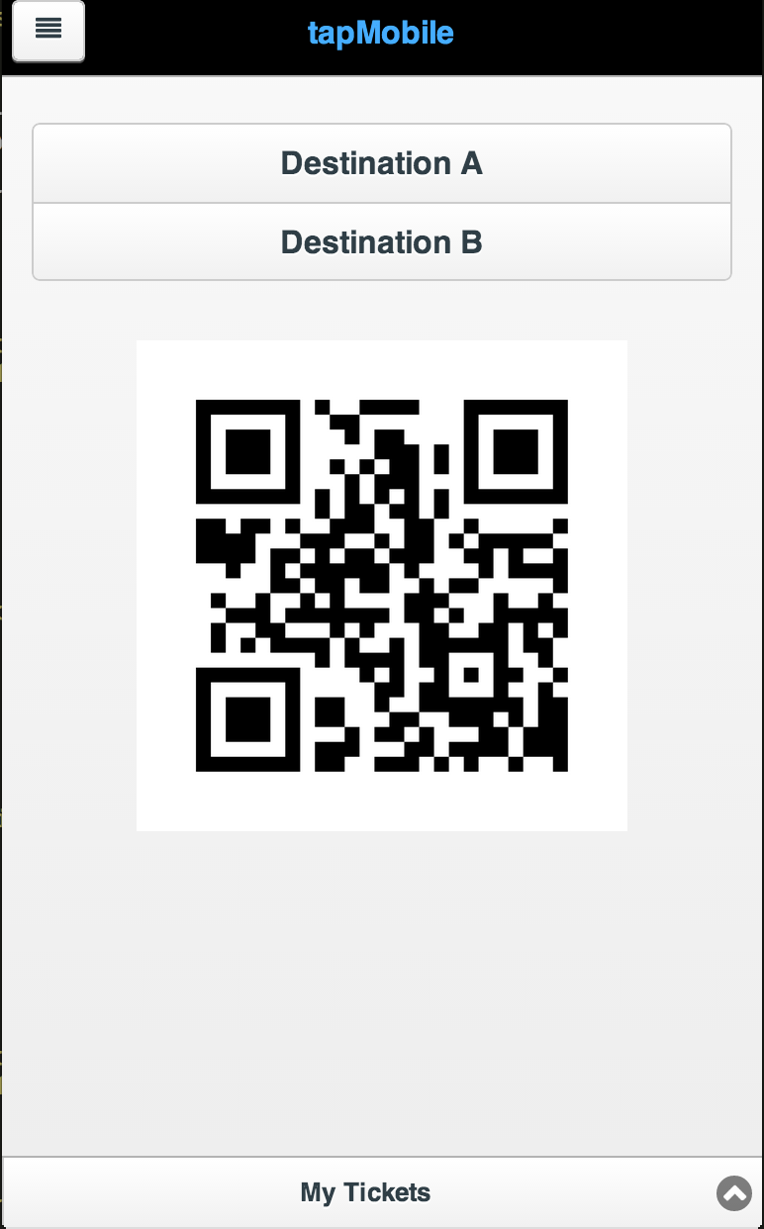
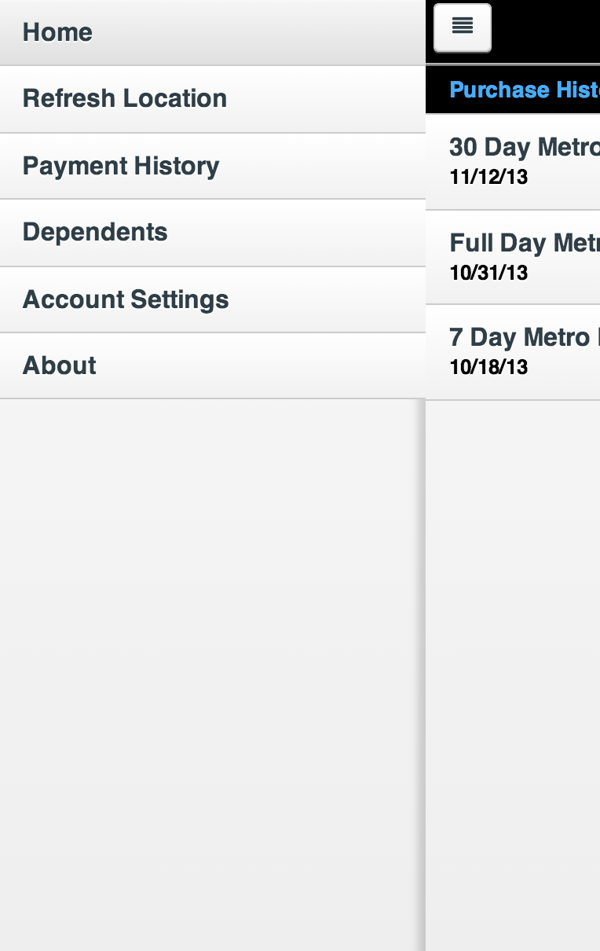
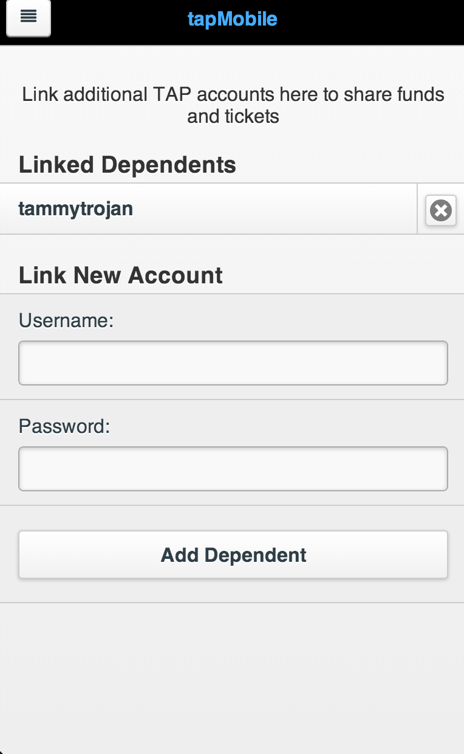
Updated Prototype Demo
Link to prototype

Slide 20
Requirements
Requirements Updates
High Priority Requirements
Level of Service Requirements
Planning Poker
Priority and Ranking of Features

Slide 21
Requirements Updates
The application shall display a static map of the Metro lines
The application shall allow each user to store one (1) credit card
The application shall support remote adjustment of ticket prices (e.g., senior discount) by TAP id through a web interface
The user shall be able to link up to five (5) dependents (name & birthdate) to their account
The user shall be able to select up to two (2) dependents included on any transaction
If the dependent is over 5 years old, the application shall calculate the additional fare

Slide 22
High Priority Requirements
The application shall be compatible with the iOS platform.
If it is a user’s first-time opening the application, the application shall prompt the user to enter an email address, password, birthdate, credit card information, and to create or link to a TAP account. If user already has account and is on new device- provide an alternative option to log in
If the user selects to purchase a ticket, the application shall check to see if the user has an applicable TAP pass.
If the user has an applicable TAP pass, the application shall generate the selected virtual ticket.
If the user does not have an applicable TAP pass, the application shall confirm with the user that it will charge the connected credit card.
If the card does not process, an error message shall be displayed and the order shall not be accepted
If the transaction succeeds, the application shall create a virtual ticket

Slide 23
High Priority Requirements
If the user selects to user their ticket, the application shall signal the gate/reader up to a maximum of 3 attempts at 20 ± 5 second intervals.
The application shall allow administration to verify tickets using a QR scanner.
The application shall allow users to delete their account.
The application shall allow users to choose whether the app confirms payment or automatically performs the transaction.
The application shall provide visual and sound feedback upon completion of a transaction.

Slide 24
Level of Service Requirements
Requirement | Desired Level | Accepted Level
Concurrent Users | 150,000 | 75,000
User Location Time | 7s | 15s
Transaction Time | 5s | 10s
% first-time users able to purchase ticket without external help | 85 | 80
Average time for user to create an account | 60s | 90s
Failed ticket transactions per 1000 | .25 | 1

Slide 25
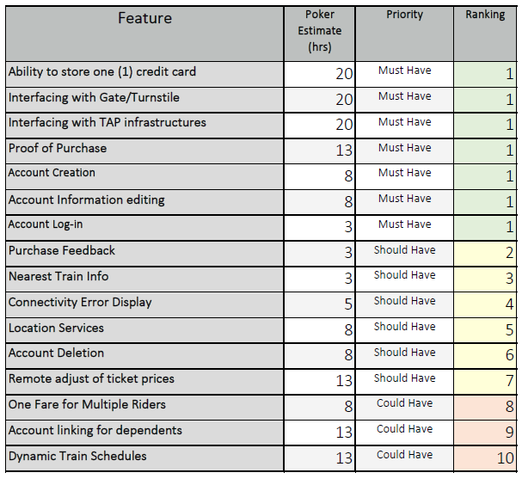
Planning Poker
Notes:
Talk about how we looked at the metro app to see what they had, and used that to prioritize what we needed

Slide 26
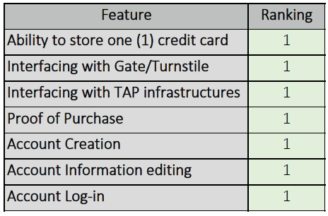
High Priority Features & Ranking

Slide 27
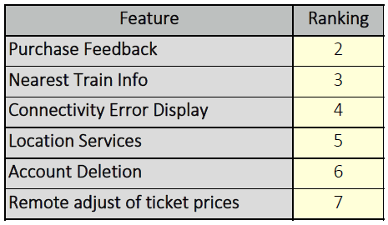
Medium Priority Features & Ranking

Slide 28
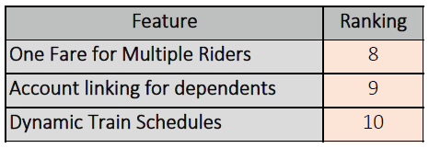
Low Priority Features & Ranking

Slide 29
Architecture
Overall Architecture
Detailed Architecture
Design
COTS/Reuse

Slide 30
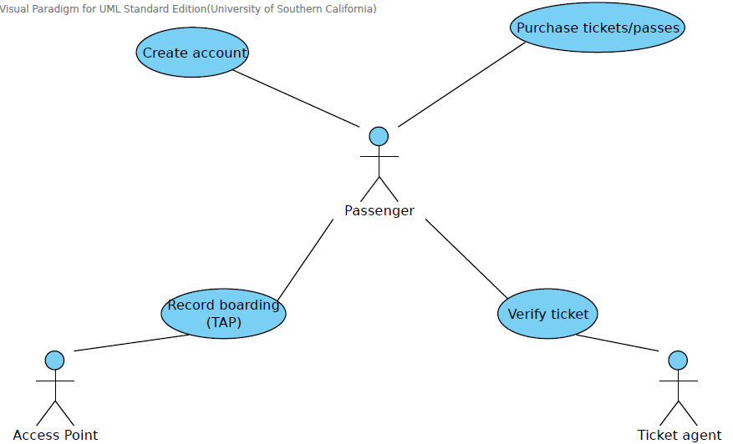
Overall Architecture

Slide 31
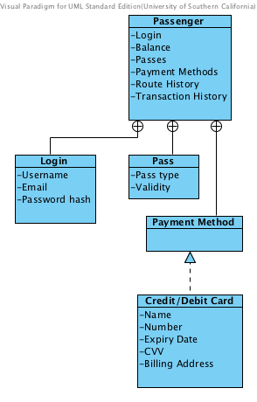
Detailed Architecture
Classes shown in this figure

Slide 32
Design
Focused on simple, easy to use interface and design
Color scheme was inspired by the current colors on TAPs website
Design was updated after feedback from over 40 survey participants
App designed to look nice and function properly on multiple platforms and devices

Slide 33
COTS/reuse Selections
PhoneGap
Allows for simultaneous development on multiple platforms
Enables portable apps
Fluid UI
Prototype development

Slide 34
Feasibility Evidence
Major Risks
Risk Tracker
Risk Management Overview
User Personas
Existing Personas Summary
New Persona

Slide 35
Security Risk
Description: An unsecure platform can be exploited (e.g. loopholes to avoid fees, reusing tickets, etc.)
Risk Exposure (Revenue approach):
Risk Mitigation Actions: Our group’s architect will chose an existing encryption system for our application that will be tested until it meets the client’s requirements and security standards

Slide 36
Technology Risk
Description: A technical malfunction of our platform might cause boarding delays for passengers and cause inefficiencies in LA Metro operations
Risk Exposure (Revenue approach): (higher probability, more passengers affected, quicker fix)
Risk Mitigation Actions: A back-up system will be designed in a later state of the project. Also, we will advice passengers who are particularly sensitive to delays to have a back-up physical tap card.

Slide 37
[New] Requirements Risks
Description: After the platform has been implemented and integrated, the LA Metro/TAP requirements might change, or the technologies being used in relevant processes might change
Risk Exposure (Cost Approach): (higher uncertainty and potentially longer fix) Previous $672-$1008
Risk Mitigation Actions: If we are under a contract/agreement the team will develop update/patches that will adapt to new requirements. Otherwise, we will give the LA Metro a copy of our comprehensive documentation for the software so that necessary changes can be handled in-house or outsourced to another contractor
Actual Steps Taken: Conducted survey to evaluate currently prototyped features. Good feedback overall, so lower risk exposure.

Slide 38
[New] Platform Compatibility Risks
Description: We will be using PhoneGap to implement the mobile application with standard web technologies like HTML/CSS/Javascript which makes the application subject to device-specific mobile browser display discrepancies.
Risk Exposure (Cost Approach): High probability of minor issues, less uncertainty. Previous: $344-$1742
Risk Mitigation Actions: Test on a wide variety of devices (different iPhone versions, Windows phone and various Android phones) to ensure the application is rendered properly on all screen sizes and OS versions
Actual Steps Taken: Researched developing natively for each platform but not feasible given time and expertise. Tested PhoneGap apps and found they run better than predicted (lower risk exposure).

Slide 39
[New] Network Compatibility Risks
Description: Since our app will require a live connection to TAP/LA Metro infrastructure to access ticket prices, send/receive/verify data, a weak internet signal can cripple the app's functionality. This can result in lost revenue from users who cannot use the app because of weak network connectivity. This is largely an “external” risk beyond our control.
Risk Exposure (Revenue Loss Per Month): a few people will not have access to the network every day
Risk Mitigation Actions: Inform the user of connectivity error and show a more simple version of the app that does not require connectivity. For example, show last ticket price quotes, route availabilities, transaction history. If possible, work with LA Metro to develop manual ticket checking system using app without connectivity or use alternative methods such as Bluetooth.

Slide 40
[New] Other Risk Tracker
 | Risk Description | Risk Mitigation Actions | Actual Steps Taken
Partnership | LA Metro might not be willing to implement our system, or allow us to test compatibility with their system | Our project manager is currently in talks with the LA Metro authorities, but we could also potentially do a proof of concept using similar hardware/systems. | Shifted targeting focus to TAP instead of LA Metro. Emailed TAP.
Estimation | The estimated amount of work might not be completed in two semester, or another developer might implement the system first. | We will develop a running list of unexpected risks as they come up and develop strategies to approach them. For example, we would explicitly ask LA Metro for their timeline and ask for an exclusive partnership. | Shifted targeting focus to TAP instead of LA Metro.
People | Team members might lack necessary expertise in certain development requirements. | Identify team member skills and project requirements so we can individually prepare ourselves for technologies that we will be implementing next semester. | Find software tools that can help us create a functional app more easily
Organizational | Statically defined team roles might not fit specific project requirements. | Dynamically reassign team roles as the project and its requirements mature. Also the team shall be aware that responsibilities will be very flexible and we may need to step outside the scope of our assigned position | Assign responsibilities dynamically via Asana and in more frequent group meetings.

Slide 41
Risk Management Plan Overview
Security
Utilize tested encryption system
Technology
Develop non-normative scenarios and have disclaimers
Requirements
Comprehensive documentation and updates based on survey feedback
Platform
Testing on major platform types
Network
Streamlined functionality and/or other communication methods

Slide 42
Previous User Persona’s Summary
Persona | Age | Occupation | Attributes | Information Sources
White Collar Worker | 25 | Financial Consultant | Organized, intelligent, tech-savvy, busy, hard-working | Wall Street Journal, The Daily Show, Facebook, Word of Mouth from colleagues and friends
Student | 21 | Student | Adventurous, diligent, social, curious | Facebook, Pinterest, The Daily Trojan, Cosmopolitan
Blue Collar Worker | 40 | Construction Worker | Hard-working, dependable, family-man | LA Times, ABC News, NPR Radio
Working Mom | 31 | Sales Associate | Busy, Enthusiastic | Facebook, Twitter, Blogs, Time magazine, co-workers and friends
Senior Citizen | 68 | Retired | Experienced, skeptical, relaxed | Radio, CNN and other TV news, The Herald Tribune and other popular Newspapers

Slide 43

[New] User Persona: Power User
Name: Dexter Barnes Age: 29 Occupation: IT Consultant Hometown: San Francisco, CA Attributes: Curious, Quirky, Creative, Innovative
Goals: Be involved in cutting-edge technology, helping clients achieve IT objectives, have fun using technology
Information Sources: Facebook, Tech Crunch, Wired, Twitter
Description: Dexter graduated from college in 2006, and has been working as an IT consultant since then. He is what a marketing professional would label as an “innovator” - someone who is willing to take risks to have the first crack at a new innovation. He is known as the most tech-savvy among his friends because he loves to try out new apps, just for the thrill of using something new.
User Scenario: Dexter takes the Metro occasionally and has a TAP card, but he would be very quick to jump at the chance to use an automated mobile TAP application because of his tech-savvy lifestyle. He also wants to maintain his reputation of being an “innovator”, and would be willing to take a risk to be one of the first people to try out a new app such as TAP Mobile.

Slide 44
Life Cycle Plan
Team Structure
Team Roles
477b Plan Overview
Timeline
Iteration Plan
Initial Cycle Plans, Construction, Transition
Cost Estimation

Slide 45
Team Structure- Implementation
Project Management
Front End
Ian
Andrew
Back End
Nakul
Elisabeth
Katherine
Jorge
Rishi
Implementers

Slide 46
Team Roles- Testing and Training
Tester
Ian Malave
Andrew Borba
Trainer
Elisabeth Brooks
Katherine Hu
Jorge Go
Rishi Mukhopadhyay
Team 1: TAP
Nakul Joshi

Slide 47
477b Roles and Responsibilities
Team Member | Role | Responsibility
Elisabeth Brooks | Project Manager | Create and manage schedules Maintain project management tool (Asana) Hold team members accountable
Ian Malave | Requirements Engineer Front End Developer | Develop front-end and prototype Update requirements to match prototype
Andrew Borba | Prototyper Front End Developer | Create application prototypes Develop the front-end
Katherine Hu | Life Cycle Planner Front End Developer | Validate application design Ensure user-friendliness and legibility
Nakul Joshi | Systems Architect Back End Developer | System & security design on high-level back-end development Manage LaTeX documentation
Jorge Go | Feasibility Analyst Back End Developer | Identify and analyze risks Plan risk mitigation strategies Run business case and cost-benefit analysis
Rishi Mukhopadhyay | Operational Contact Engineer Back End Developer | Implement back-end Plan database structure

Slide 48
477b: Spring Timeline
Jan. - Feb. : Work with teams:
Rebaseline prototype, prioritize requirements
Plan for CS 477b specifics, including transition strategy, key risk items
Participate in ARB review
Mar 3- 7: Iteration Assessment Reviews
Feb – May : Scheduled Weekly Meetings with Teams to:
Discuss status and plans
Provide access to key transition people for strategy and readiness discussions
Mar 26: Core Capability Drivethrough
Apr 14 - 18: Project Transition Readiness ARB Reviews
Apr 21: Installation and Transition
Install Product
Execute Transition Plan
Apr 28: Operational Commitment Review for Initial Operational Capability
May 5: Client Evaluations

Slide 49
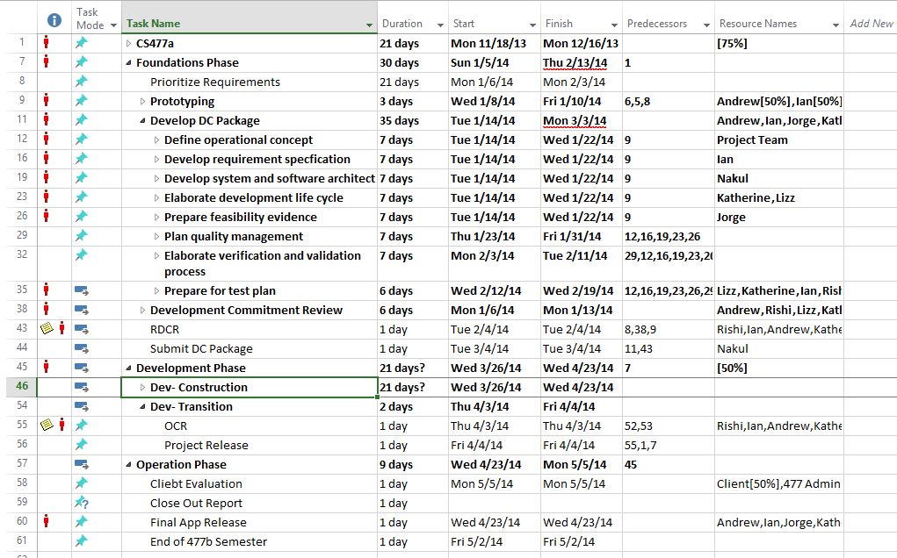
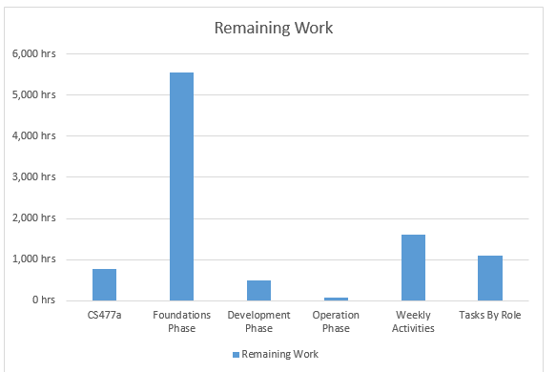
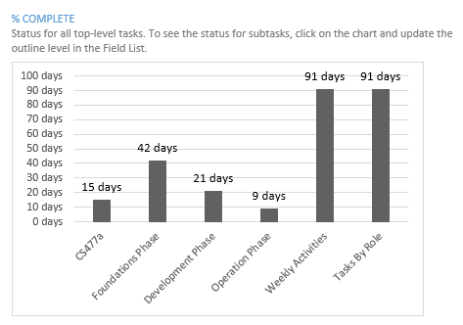
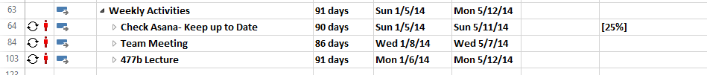
MS Project Timeline

Slide 50
477b Plan Overview- Spring Milestones
Foundations Phase
Team reformed, project assigned
RDCR: Rebaselined Development Commitment Review
Development Phase- Construction
CCD: Core Capability Drivethrough
TRR: Transition Readiness Review
Development Phase- Transition
OCR: Operational Commitment Review
Operation Phase

Slide 51
Initial Cycle Plans
Construction Iteration (1): Feb 3 – Mar 2 (4 weeks)
Construction Iteration (2): Mar 3 – Mar 16 (2 weeks)
Iteration Assessment Preparation & Review: Feb 24 – Mar 7
Spring Break: Mar 17- Mar 23
Construction Iteration (3): Mar 24 – Apr 6 (2 weeks)
Project Transition Readiness ARB Preparation & Review: Apr 7 – Apr 18
Transition Iteration: April 21-28 (1 week)

Slide 52
Iteration Plan- Implementation and Testing
Construction Iteration (1)
Construction Iteration (2)
Construction Iteration (3)

Slide 53
Construction Iteration (1)

Slide 54
Construction Iteration (2)

Slide 55
Construction Iteration (3)

Slide 56
Three Point Estimate
Feature | Estimated Hours to Complete
 | Best Case | Most Likely Case | Worst Case | Expected Case
Ability to Store (1) Credit Card | 18 | 20 | 22 | 20
Interfacing with Gate/Turnstile | 18 | 20 | 22 | 20
Interfacing with TAP Infrastructures | 18 | 20 | 22 | 20
Proof of Purchase | 11 | 13 | 15 | 13
Account Creation | 6 | 8 | 10 | 8
Account Information Editing | 6 | 8 | 10 | 8
Account Login | 2 | 3 | 5 | 3

Slide 57
Three Point Estimate
Feature | Estimated Hours to Complete
 | Best Case | Most Likely Case | Worst Case | Expected Case
Purchase Feedback | 1 | 3 | 5 | 3
Nearest Train Info | 1 | 3 | 5 | 3
Connectivity Error Display | 3 | 5 | 7 | 5
Location Services | 6 | 8 | 10 | 8
Account Deletion | 6 | 8 | 10 | 8
Remote Adjust of Ticket Prices | 11 | 13 | 15 | 13

Slide 58
Three Point Estimate
Feature | Estimated Hours to Complete
 | Best Case | Most Likely Case | Worst Case | Expected Case
One Fare for Multiple Riders | 6 | 8 | 10 | 8
Account Linking for Dependents | 11 | 13 | 15 | 13
Dynamic Train Schedules | 11 | 13 | 15 | 13

Slide 59
Cost Estimation
Construction Iteration (1) Estimate: 92 Hours
Construction Iteration (2) Estimate: 40 Hours
Construction Iteration (3) Estimate: 34 Hours
Transition Iteration Estimate: 20 Hours
Total Hours Estimate: 186 Hours
Apple Developer License $99, Windows Environment
Printing for each presentation: $15-20 x 5 = $75-100
Total Cost Estimate: $180

Slide 60
Thank You
Questions?

